Slide 1
CS-UY 2214: Rec 4
E20

Slide 2
E20
(Related sections in E20 Manual highlighted in blue!)

Slide 3
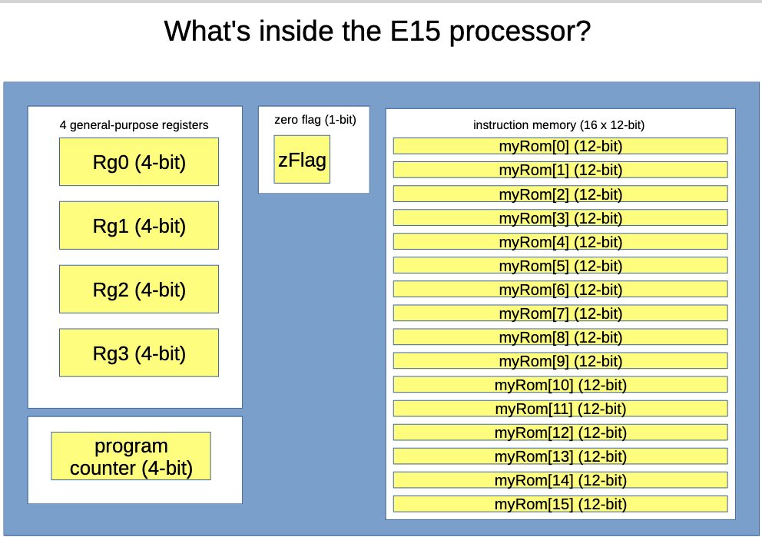
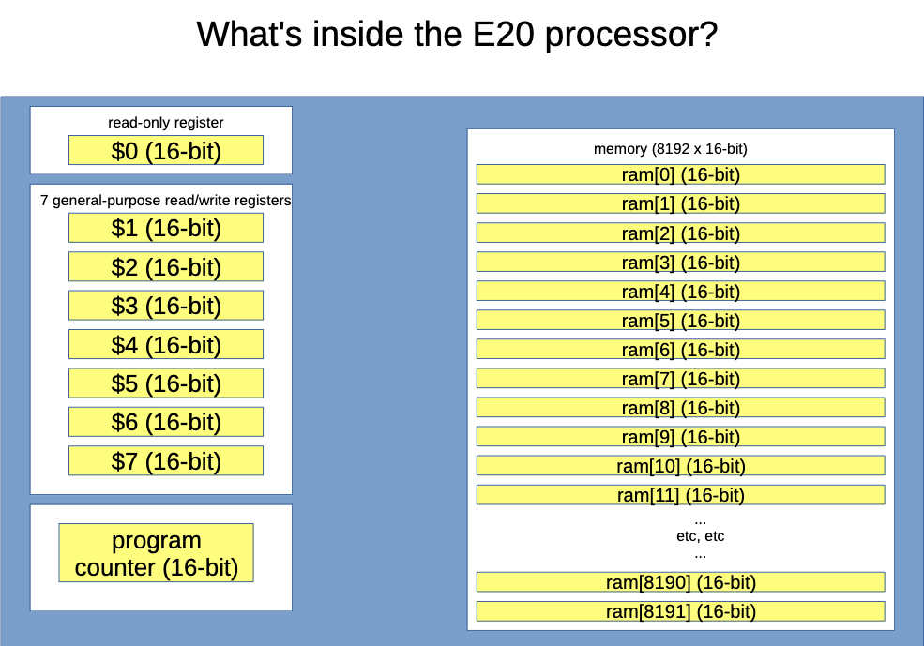
E15 vs. E20 (Section 2.6: ‘E15 vs. E20’ )

Slide 4
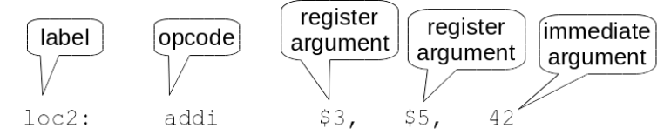
E20 Basics (Section 2: ‘Architecture’ )
Sizes:
Memory Addresses = 16 bits <- (but we only use the 13 LSBs)
Memory Cell = 16 bits <- contains instructions/data
Registers & PC = 16 bits
8 Registers
$0 stores 0 and is read-only (can write to $0 but it won’t save anything)
Cells not containing instructions/data are 0

Slide 5
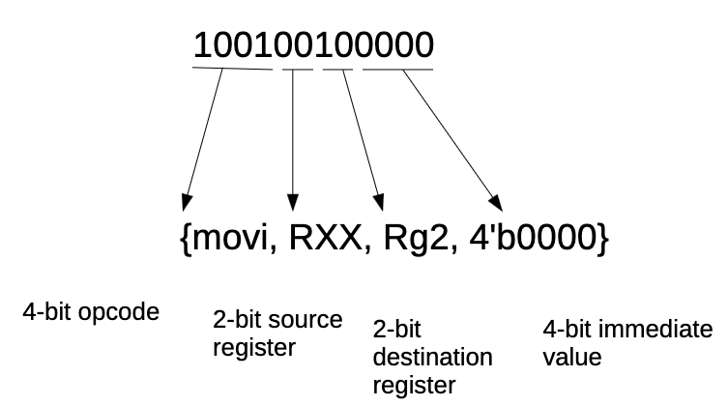
E20 Instructions (Section 3: ‘Instruction Set’ )
Unlike E15, instructions in E20 encoded differently depending on number of register arguments:
<- NOT CONSISTENT LIKE THIS!

Slide 6
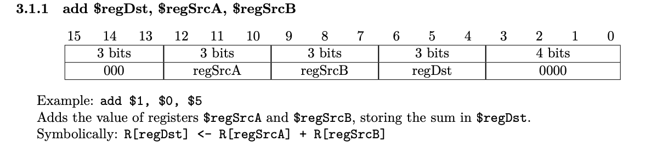
E20 Instructions (Section 3: ‘Instruction Set’ )
NOTICE DIFFERENCE IN ORDER OF ARGUMENTS BETWEEN ASSEMBLY LANGUAGE AND MACHINE CODE!!

Slide 7
E20 Instructions (Section 2.6: ‘E15 vs. E20’ )
Three Instruction formats:
3 Register Arguments | 2 Register Arguments | No Register Arguments
3-bit “Opcode” | 3-bit Opcode | 3-bit Opcode
Three 3-bit reg fields | Two 3-bit reg fields | None
4-bit Imm (“Sub-Opcode”) | 7-bit Imm | 13-bit Imm

Slide 8
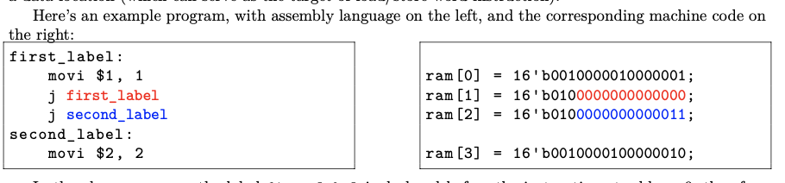
E20 - Labels (Section 2.3: ‘Memory’ )
Names given to addresses in memory
Essentially just a number we want to remember!
Handy if we want to return to a memory address multiple times
Can be used as immediate value:

Slide 9
THE VALUE OF A LABEL IS THE MEMORY ADDRESS WHERE IT IS DEFINED

Slide 10
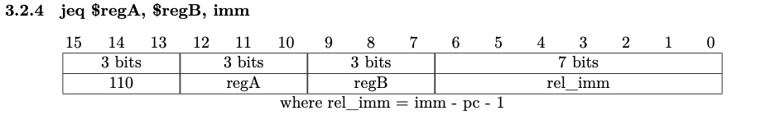
Jumps (Section 3.2: ‘Instructions w/ two register arguments’ )
Four jump instructions: ‘j’, ‘jal’, ‘jr’, ‘jeq’
Rather than adding value to current pc (E15), pc jumps to address equal to value
(‘jeq’) If regA == regB, pc jumps to imm;
Instead of imm, rel_imm encoded in machine code (bc of 7-bit imm field)

Slide 11
Memory Instructions (Section 3.2: ‘Instructions with two register arguments’ )
‘lw’ - Load word:
Reads values from memory, “loads” it into destination register
Ex. ‘lw $2, imm($1)’
Goes to address = imm + value in $1; reads value at address and copies it into $2
Symbolically equivalent to: ‘R[$2] <= mem[R[$1] + imm]’
‘sw’ - Store word:
Writes value into memory from source register (value “stored” in memory)
Ex. ‘sw $2, imm($1)’
Goes to address = imm + value in $1; stores value from $2 at that address
Symbolically equivalent to: ‘mem[R[$1] + imm] <= R[$2]’
This means your programs can modify themselves during runtime!

Slide 12
Pseudo-Instructions (Section 3.4: ‘Pseudo-instructions’ )
Shorthand for commonly used instructions.
‘nop’ -> No operations
Encoded as ‘add $0, $0, $0’
‘halt’ -> (Ends program)
Encoded as ‘j current_address’
‘movi $reg, imm’
Encoded as ‘addi $reg, $0, imm’

Slide 13
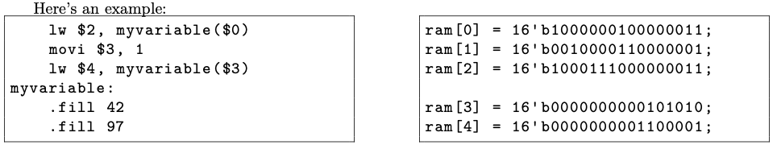
Assembler Directives (Section 3.5: ‘Assembler directives’ )
Not instructions for processor!
Commands to assembler itself; runs during assembly time
Ex: ‘.fill some_label’
Insert the 16-bit value of some_label into memory at current location
Ex: ‘.fill 42’
Insert the 16-bit value of 42 into memory at current location

Slide 14
E20 Manual is ur bff now <3
Read it thoroughly! It has EVERYTHING!!

